Slide 1
High dynamic range
Image forensics

Slide 2


Introduction
Proposed methods
Experiments
Conclusion

Slide 3
01
Introduction
HDR image
Restriction of camera sensors’ dynamic range →
Easy to be overexposed or underexposed
mHDR
Fusing the overexposed image and underexposed image can preserve the complete information of the scene
iHDR
Generate HDR image from one LDR using iTMO
iHDR, mHDR were hardly distinguished by naked eyes
Performed mHDR image and iHDR image classification based on CNN
Proposed network learns and detects statistical changes of the luminance channel of HDR image automatically

Slide 4
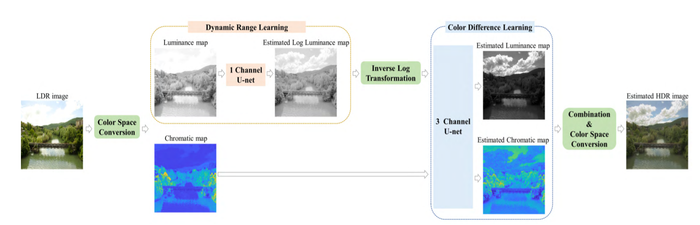
01
High Dynamic Range Image(iHDR)
Extract the luminance and chromatic information from the LDR image
Estimate the luminance of the HDR from the luminance of the LDR (using Dynamic Range Learning model)
Estimate the chromatic information of the HDR by using the estimated HDR luminance (using Color Difference Learning model)
Recombine the estimated luminance and chromatic information

Slide 5
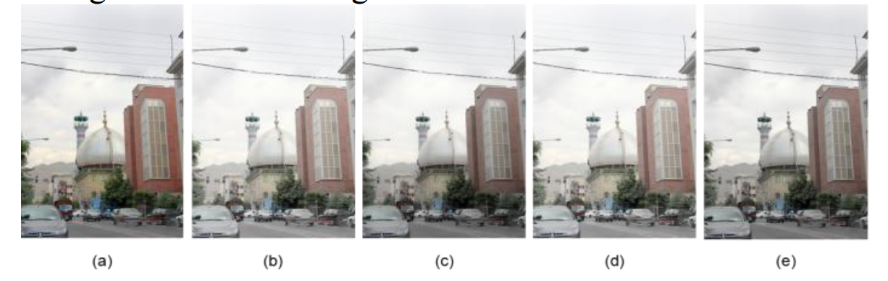
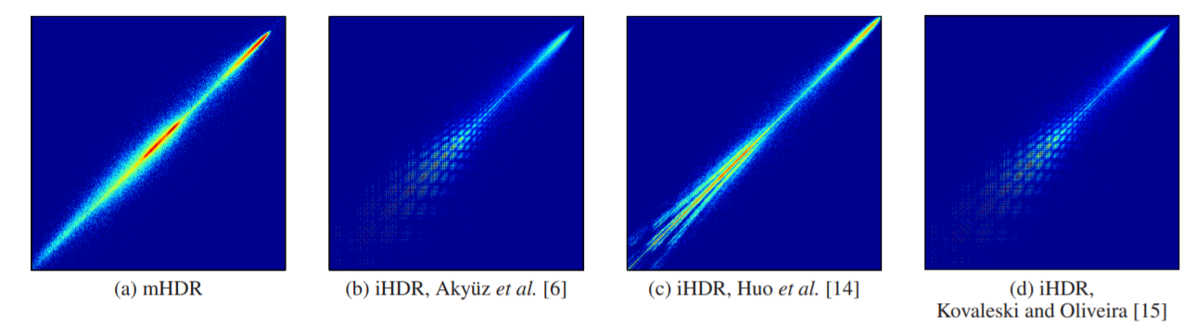
01
High Dynamic Range Image
mHDR has more luminance details compared to iHDR image
Joint histogram (joint probability or co-occurrence matrix of neighboring pixels)
iHDR images is sparser than that of mHDR image, especially in small pixel values

Slide 6
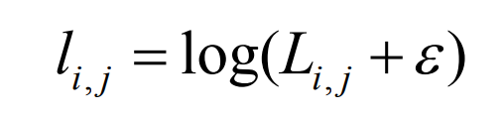

02
Pre-processing
Manipulation of generating HDR images mainly function on luminance channel
In RGB channel, the objects and edges of the scene can be interference when using CNNs to learn features automatically.
Luminance channel
The maximum and minimum luminance values of different HDR image vary largely across different image → compensate image-dependent peak brightness in HDR image.
Transform

Slide 7
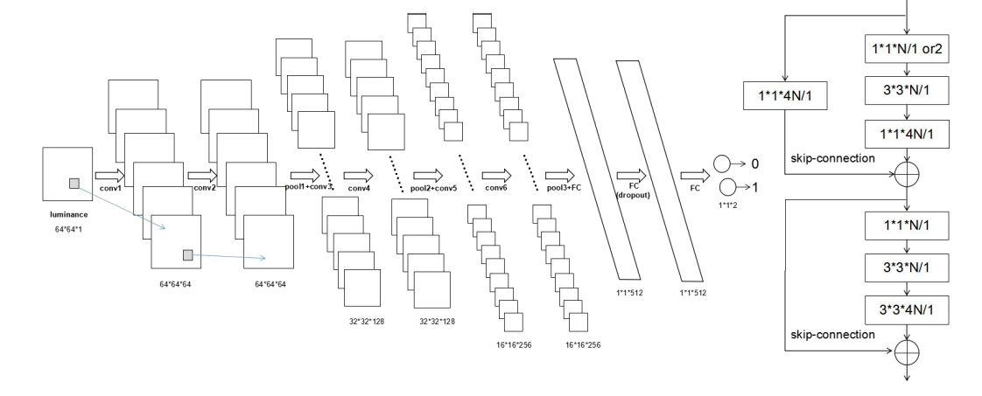
02
CNN
Without residual block vs with residual block
- Guide the feature extraction automatically

Slide 8
02
CNN
Without residual block vs with residual block
Without residual block
- ReLU activation function
- Max-pooling
- Dropout in fully connected layer
- Cross entropy loss function
- Softmax activation
With residual block
- Replace all convolutional layers with residual blocks
- Before residual blocks, add large kernel convolution layer and overlapping average pooling layer
- Second fully-connected replace by average pooling

Slide 9
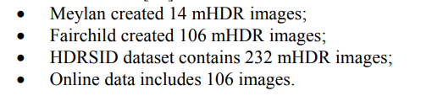
03
Experiment
Dataset(mHDR) - 458
For train
Divide into 64x64
Shuffle completely
(60000 image blocks, ratio of mHDR and iHDR blocks is 1:1)
Dataset 1.0(for verification)
Pick out 40 images for iHDR, mHDR
Divide into 64x64
Shuffle completely
Dataset 2.0(for verification)
Remaining image blocks
Pick out 406 mHDR images whose scene is not very similar to each other
Dataset(LDR) - 406
Mitadobe5k(high-quality, high-resolution image)
Pick out randomly
Dataset(iHDR) – 406
Create iHDR image(for kinds of iTMOs)

Slide 10
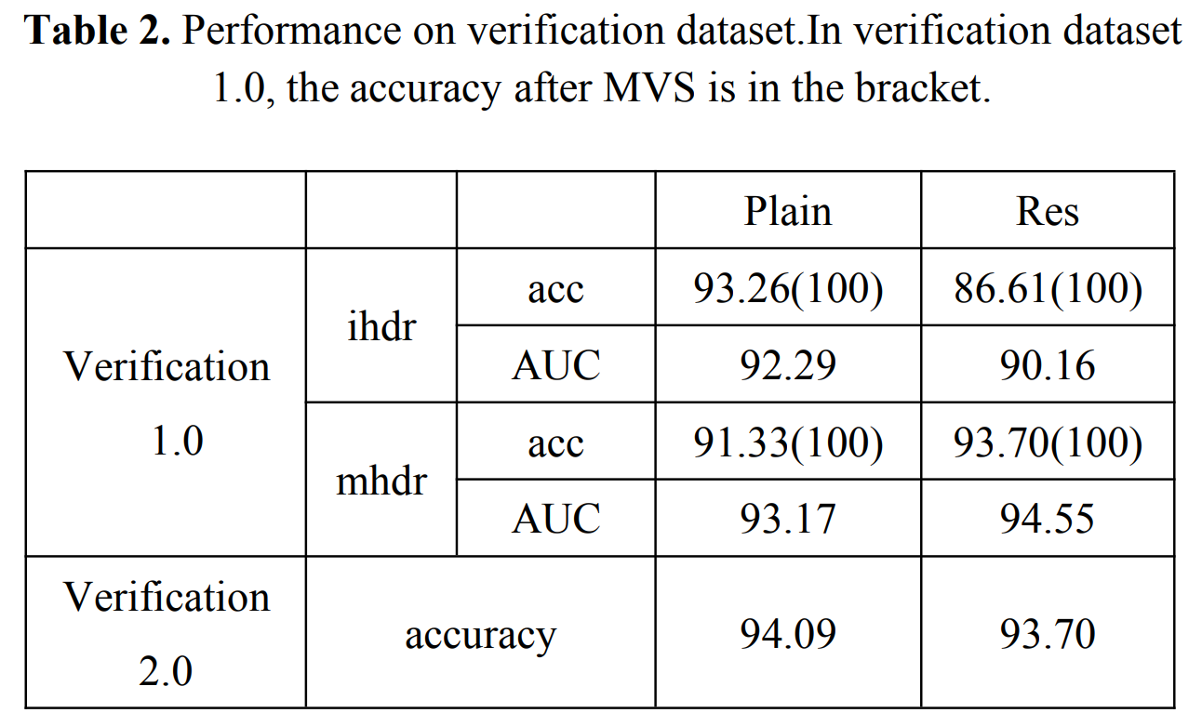
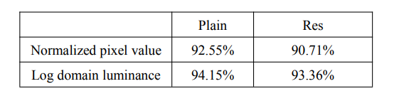
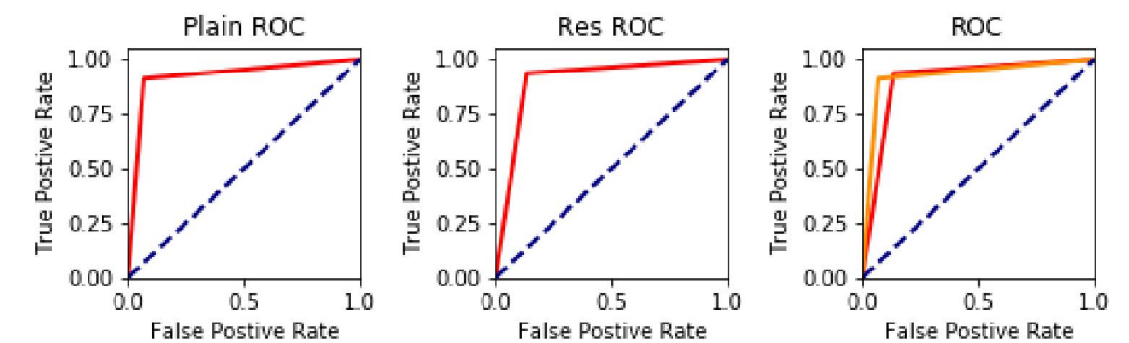
03
Experiment
Advantage of using log domain luminance
Plan vs Residual block

